Slide 1
Embedded Operating Systems
4.1 Memory Management
Shripad V Deshpande

Slide 2
Memory - Introduction
Storage needed by the kernel, the other components of the operating system and the user programs.
In a multi-processing, multi-user system, the structure of the memory is quite complex.
Efficient memory management is very critical for good performance of the entire system.

Slide 3
MEMORY: BASIC CONCEPTS
m × n memory
Stores large number of bits
m x n: m words of n bits each
k = Log2(m) address input signals
or m = 2^k words
e.g., 4,096 x 8 memory:
32,768 bits
12 address input signals
8 input/output data signals
Memory access
r/w: selects read or write
enable: read or write only when asserted
…
m words
…
n bits per word
memory external view
r/w
2^{k} × n read and write memory
enable
A₀
…
A_{k-1}
…
Q_{n-1}
Q₀

Slide 4
MEMORY: BASIC CONCEPTS
Processor Memory (Register Array)
Cache Memory
Internal on-chip Memory
Primary Memory
Secondary Memory

Slide 5
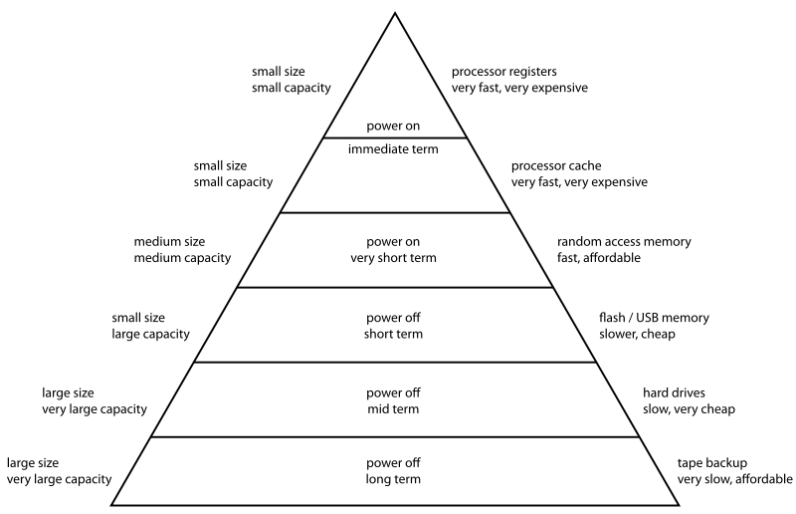
MEMORY HIERARCHY

Slide 6
Memory management requirements
Relocation: Branch addresses and data references within a program memory space (user address space) have to be translated into references in the memory range a program is loaded into.
Protection: Each process should be protected against unauthorized access by other processes, whether accidental or intentional.
Sharing : Allow several processes to access the same portion of main memory : very common in many applications. Ex. many server-threads executing the same service routine.
Logical organization : allow separate compilation and run-time resolution of references. To provide different access privileges (rwx) to allow sharing. Ex: segmentation.

Slide 7
Memory management requirements
Physical organization: Memory hierarchy or level of memory (Main Memory, Cache, Secondary memory etc). Organization of each of these levels and movement and address translation among the various levels.
Overhead : should be low. System should not be spending much time in managing memory compared to executing user programs.

Slide 8
Memory management techniques
Fixed partitioning: Main memory statically divided into fixed-sized partitions: could be equal-sized or unequal-sized. Simple to implement. Inefficient use of memory and results in internal-fragmentation.
Dynamic partitioning : Partitions are dynamically created. Compaction needed to counter external fragmentation. Inefficient use of processor.
Simple paging: Both main memory and process space are divided into number of equal-sized frames. A process may exist in non-contiguous main memory pages.

Slide 9
Memory management techniques
Simple segmentation : To accommodate dynamically growing partitions: Compiler tables, for example. This technique does not create fragmentation, but needs compaction.
Virtual memory with paging: Same as simple paging but the pages currently needed are in the main memory. Known as demand paging.
Virtual memory with segmentation: Same as simple segmentation but only those segments needed are in the main memory.
Segmented-paged virtual memory

Slide 10
Basic memory operations: Relocation
A process in the memory includes instructions plus data. Instruction contain memory references: Addresses of data items, addresses of instructions etc.
These are logical addresses or Virtual addresses : relative addresses are examples of this. These are addresses which are expressed with reference to some known point, usually the beginning of the program.
Physical addresses are absolute addresses in the memory.
Relative addressing or position independence helps easy relocation of programs.

Slide 11
Basic memory operations: Linking and loading
Linker takes collection of object modules and produces a load module that consists of an integrated set of program and data to be passed to the loader. As part of this process, it resolves all the external symbolic references (linkages)in the load module.
The nature of the address linkage –
Static linking,
Load-time dynamic linking,
Run-time dynamic linking.
Dynamic linking: Deferring the linkage of external references
Loading : Placing the executable image in physical memory and starting its execution
Run time memory requirement of the program (malloc)

Slide 12
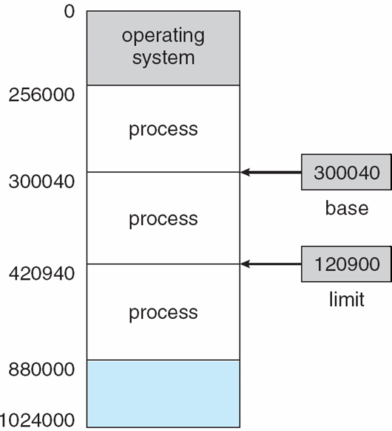
Memory Management functions - Protection
No process should be able to access even a single byte which, it is not authorized to.
Technique - Use base and limit values
address locations added to base value to map to physical address
address locations larger than limit value generates exception
Every memory access goes through the above check.

